Slide 1


Pac Man AI
Lana Tamim
Avery Munn
Micheal

Slide 2
Project Overview
Pac Man using these Game Agents:
  Planning Agent (A*): Gets the shortest and safest path using informed search
  RL Agent (Q-Learning): Makes strategic decisions. It learns from experience using rewards and penalties.
  Adversarial (Ghosts): Act as non-player agents with random, aggressive, or mixed movement strategies.

Slide 3


Tools & Implementation
Python
NumPy
  Q-tables
GitHub

Slide 4
Process
High-Level Decisions, the RL agent chooses between two high-level strategies:
0 — Chase rewards: Move toward the nearest dot
1 — Avoid threats: Move toward the safest tile
Low-Level Movement (A*) After selecting a high-level strategy: The agent uses A* to compute the optimal next move. A* ensures smooth movement.

Slide 5
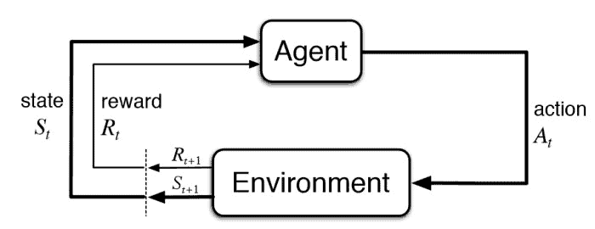
Q-Learning
Learns from rewards and penalties
States:
  Pac-Man location (quadrant)
  Ghost proximity
Actions:
  Chase reward (food/power pellets)
  Avoid danger (ghosts)

Slide 6
A*
When Q-learning selects chase or avoid, A* calculates safest or shortest path
Used for:
Navigating toward nearby pellets
Escaping ghosts

Slide 7
Experiment 1 — RL-Only vs RL + A*
Goal: Compare baseline RL agent vs hybrid RL + A*.
Results:
  RL-only avg reward: 730
  RL + A* avg reward: 1250
  RL + A* survived ~3x longer
  RL + A* collected nearly double the pellets
Conclusion:
Using A* dramatically improves planning, survival, and reward stability.

Slide 8
Experiment 2 — Exploration Schedule (ε-Greedy)
Goal: Compare constant vs decaying epsilon exploration.
Results:
  Constant ε = 0.1 → stable but slow learning
  Decaying ε from 1.0 → 0.05 → faster convergence
  Higher long-term rewards and more consistent behavior
Conclusion:
Decaying ε produced the strongest policy and best overall learning curve.

Slide 9
Experiment 3 — Ghost Difficulty Modes
Goal: Evaluate performance under different ghost behaviors.
Ghost Modes Tested:
  Random → easiest, highest reward
  Chase → predictable but more dangerous
  Mixed → hardest due to unpredictability
Conclusion:
Ghost difficulty strongly impacts agent performance and learning efficiency.

Slide 10
Takeaways
Hybrid RL + A* improved learning efficiency
Reward shaping guided desired behaviors
ε produced best long-term strategy
Ghost difficulty significantly affects learning

Slide 11
Game Demo

Slide 12

Thank You!

